Slide 1
Installing Kali Linux on Android
Chaz Dash Project 4 submission

Slide 2
Ensure your device is has Termux and NetHunter Store
Termux can be installed from Git:
https://github.com/termux
NetHunter Store can be installed from:
https://store.nethunter.com/en/

Slide 3
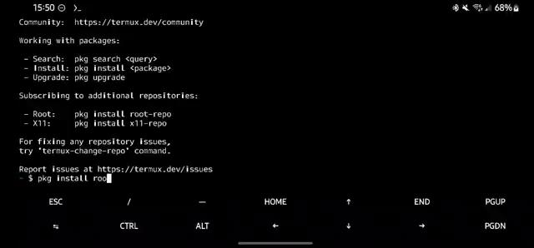
Install repositories, wget, and pull Kali image
Notes:
First you will install the root-repo and x11-repo as indicated in the opening lines of Termux, after that you’ll run apt update && apt upgrade before installing wget via apt install wget. You will then utilize wget to pull the Kali NetHunter image to prep for install.

Slide 4
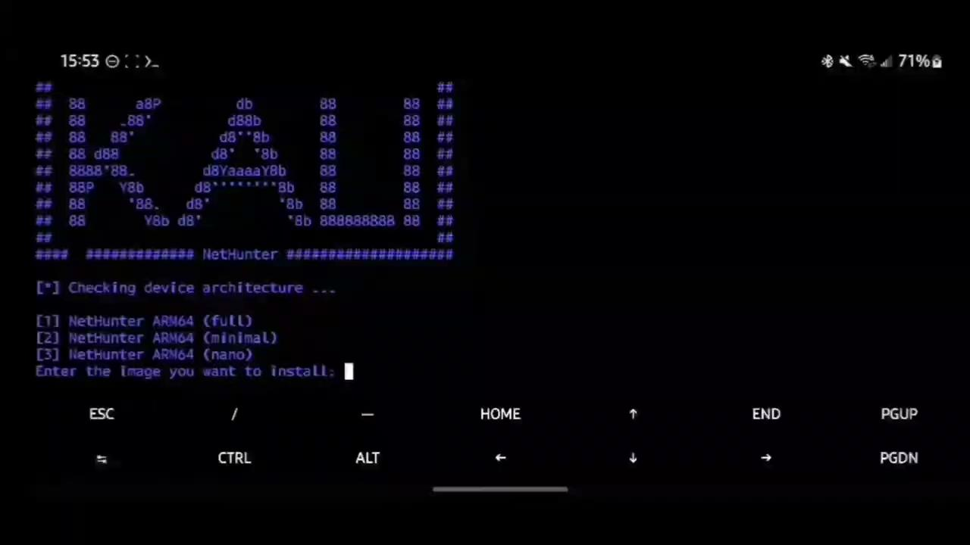
Install Kali NetHunter
(video speed increased due to time constraints)
Notes:
Using the image downloaded in the previous slide, you may now begin your Kali installation by running chmod +x install-nethunter-termux and then running the script ./install-nethunter-termux. This process may take a while depending on your chosen installation.

Slide 5
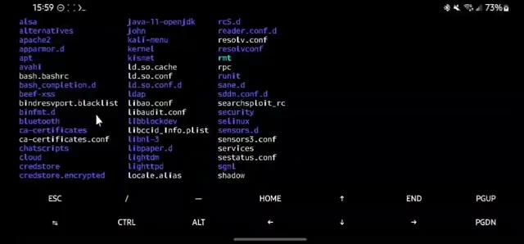
Change DNS IP to 1.1.1.1 and run sudo apt update && sudo apt upgrade
(Previous DNS address fails to resolve, borking any attempt to update or install)
Notes:
After completing the install you now have access to headless mode, the first thing you should do is change the DNS IP to a different DNS service, such as CloudFlares 1.1.1.1, as the preloaded IP appears to not be resolving. After this you can go ahead and run sudo apt update && sudo apt upgrade to get your installed services up to date. You can then back out of headless and enter nethunter kex to launch the GUI vnc server, make sure you note the port the server was started on (it should default to 5901.)

Slide 6
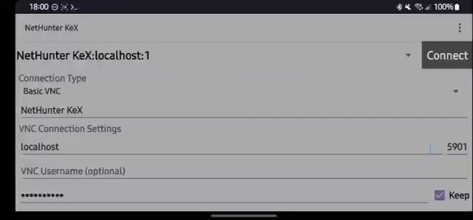
Now just utilize your favorite VNC client to access the GUI, or continue in headless mode.
Notes:
All that is left is to launch your preferred VNC client and load up your Kali GUI, or if preferred you can continue to use it in headless mode.
Either way this provides a powerful set of tools that you can access at any time, including network scanners and exploit tools such as metasploit.
While noticeably neutered compared to it’s traditional counterpart, I believe this could still be an effective options for pen testers running discreet operations involving onsite vulnerability. Afterall, if we can do it, so can those with ill-intent.

Slide 7
Thank you for your time, if anyone would like review this, it will be available on my git, including the installation video.
Git
https://www.github.com/Cannibal-Bacon/cautious-spork

